Slide 1

Real-Time Face Recognition & Detection
An End-to-End Deep Learning Framework Integrating MTCNN, VGG-Face, and YOLOv8 Models
DR. AHMED YOUSRY

Slide 2
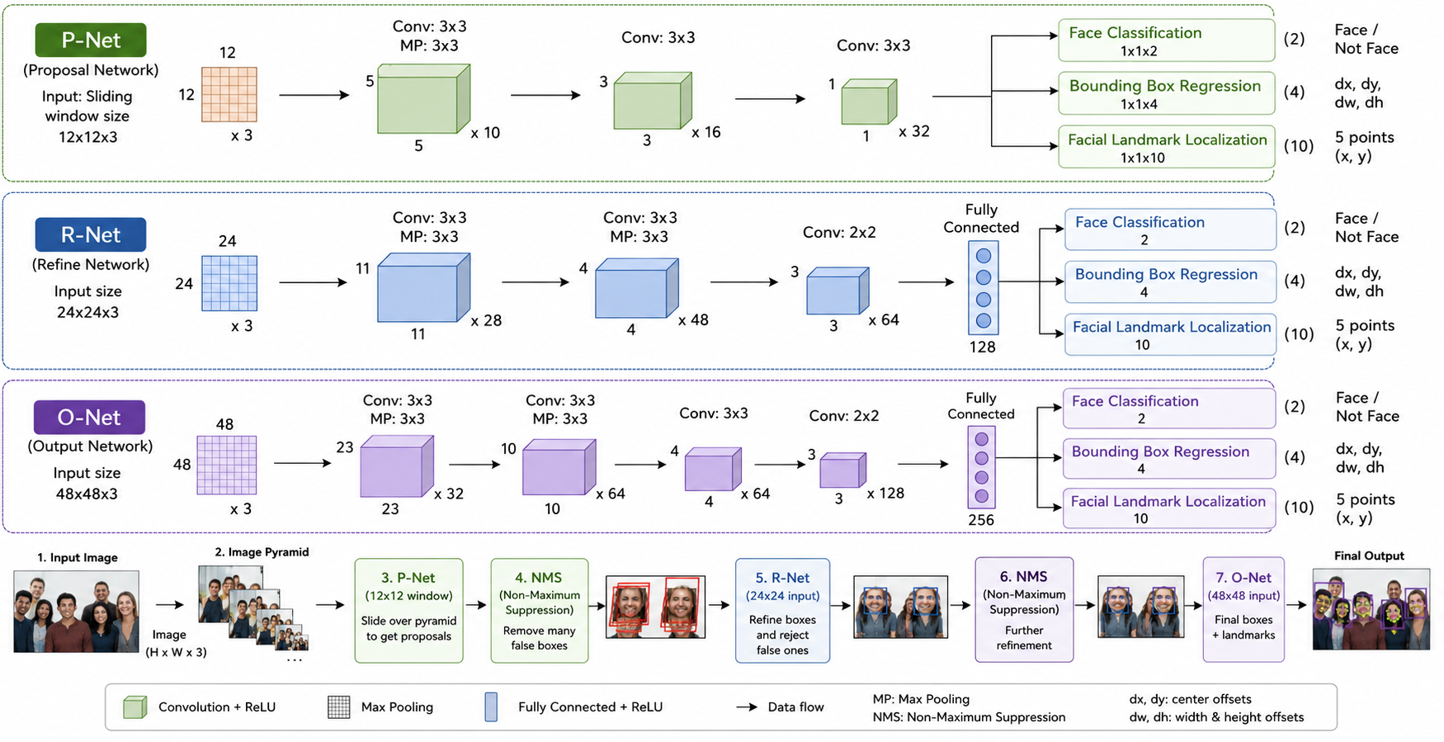

Slide 3
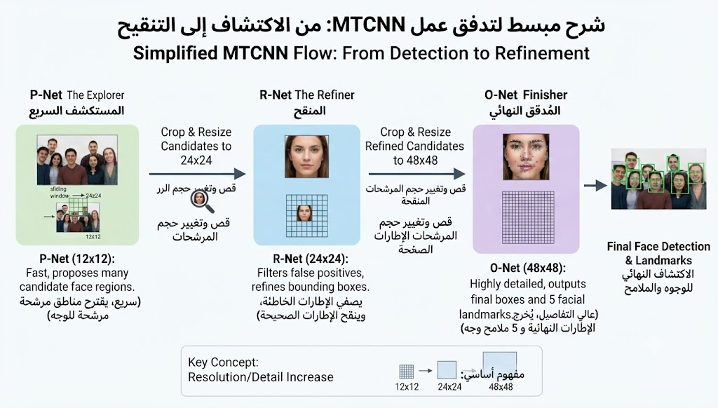

Slide 4
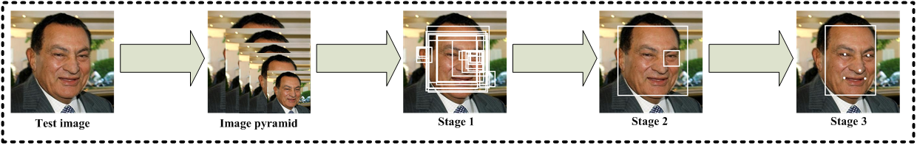
MTCNN Architecture
Stage 1 (P-Net - Proposal Network): A fully convolutional network that generates candidate windows and bounding box calibration. It uses an image pyramid for multi-scale detection.
Stage 2 (R-Net - Refinement Network): A CNN that takes the proposals from P-Net, rejects non-faces, and refines the bounding boxes using Non-Maximum Suppression (NMS).
Stage 3 (O-Net - Output Network): A more complex CNN that further refines the bounding boxes and outputs the locations of five facial landmarks (eyes, nose, mouth corners).

Slide 5


Comparison of Detection Methods
MTCNN (Multi-Stage Cascade)
YOLOv8 (Single-Stage Regression)
Accuracy-Focused: Leverages a three-tier network to detect facial keypoints and landmarks simultaneously. Offers excellent alignment precision but suffers from higher computational latency during fast movement.
Speed-Focused: Detects face bounding boxes in a single pass of the network. Built for ultra-high framerates, rendering it ideal for CPU-bound or hardware-constrained edge servers.

Slide 6


Deep VGG-Face Embeddings
2622-Dimensional Feature Vectors
To establish identity verification, cropped facial images are processed through the pre-trained VGG-Face model.
The model architecture processes normalized 224 * 224 images.
Extracted outputs map visual features into a dense vector space.
Feature representations capture subtle invariants (e.g., eye spacing, jawlines).
Class classification layers are removed to keep features highly generalizable.

Slide 7
VGG-Face Architecture
Deep Convolutional Stack: Utilizes 16 convolution layers, 5 pooling layers, and 3 fully-connected layers to construct a deep hierarchy of abstract facial features.
Truncation Point: Truncated right before the final softmax classification layer to yield pure, unclassified embedding features.
Feature Resolution: Translates complex spatial pixel relationships into a single 2622-dimensional floating-point vector.
Transfer Learning: Leverages weights pre-trained on millions of faces, eliminating the need for vast datasets to train local models.

Slide 8
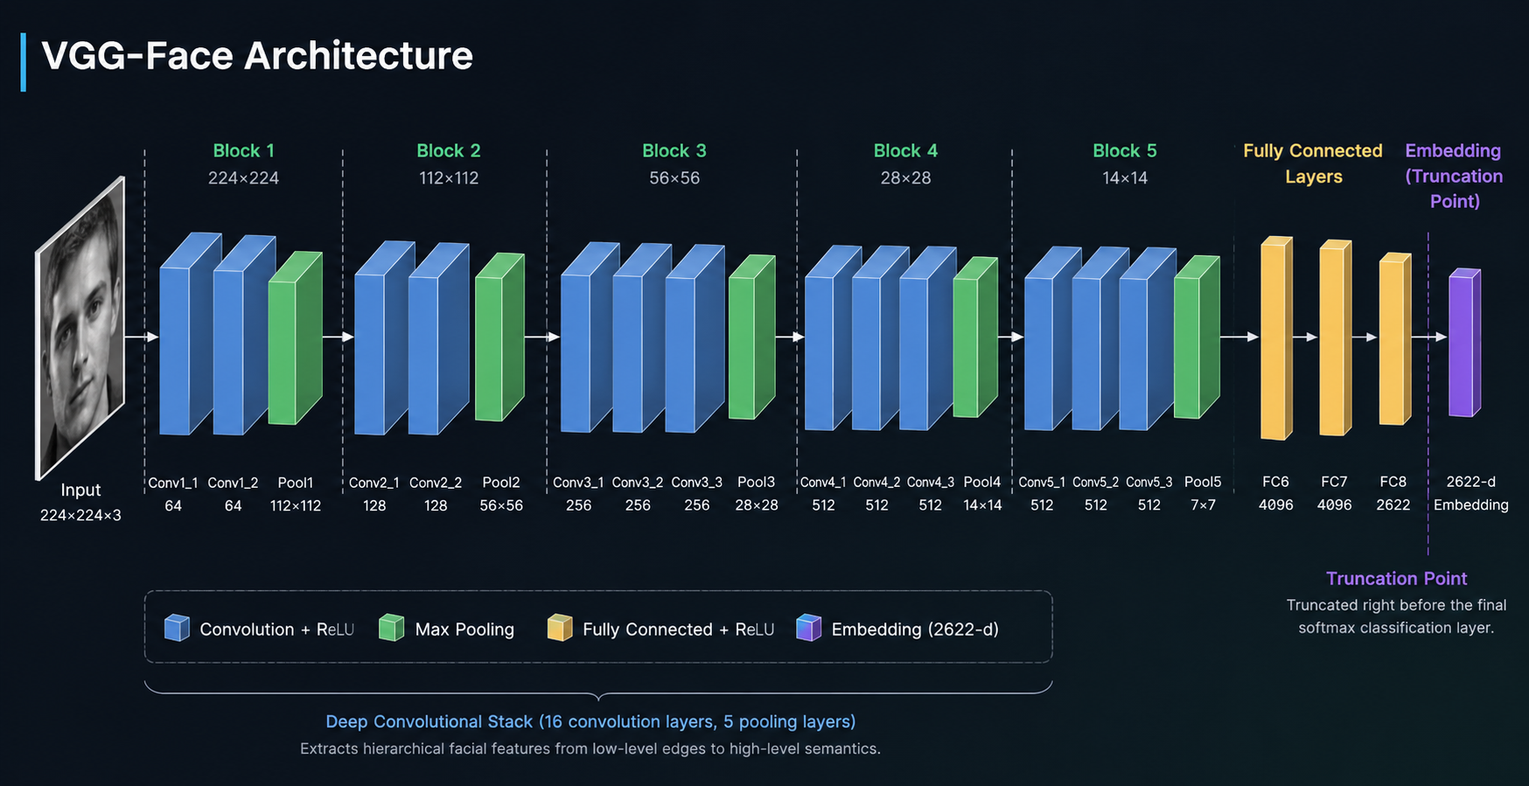

Slide 9
Real-Time Processing Pipeline
2. Detect & Track
4. Classification
Faces are located using MTCNN or YOLOv8 and tracked across frames.
Cosine similarity matches the embedding to database entries.
1. Frame Read
3. Vector Creation
Live video frames are read, duplicated for safe editing, and normalized.
Detected face ROIs are cropped and encoded into VGG-Face embeddings.

Slide 10
Similarity Distance Metrics
Inference Decisions
0.30
Cosine distance computes the angular difference between live embedding vectors and saved reference templates.
Values strictly below 0.30 signify a verified match.
Cosine Distance Cutoff Limit
Values exceeding 0.30 are designated as "Unknown".
Minimizes false-positives while adjusting for lighting and pose.

